Slide 1
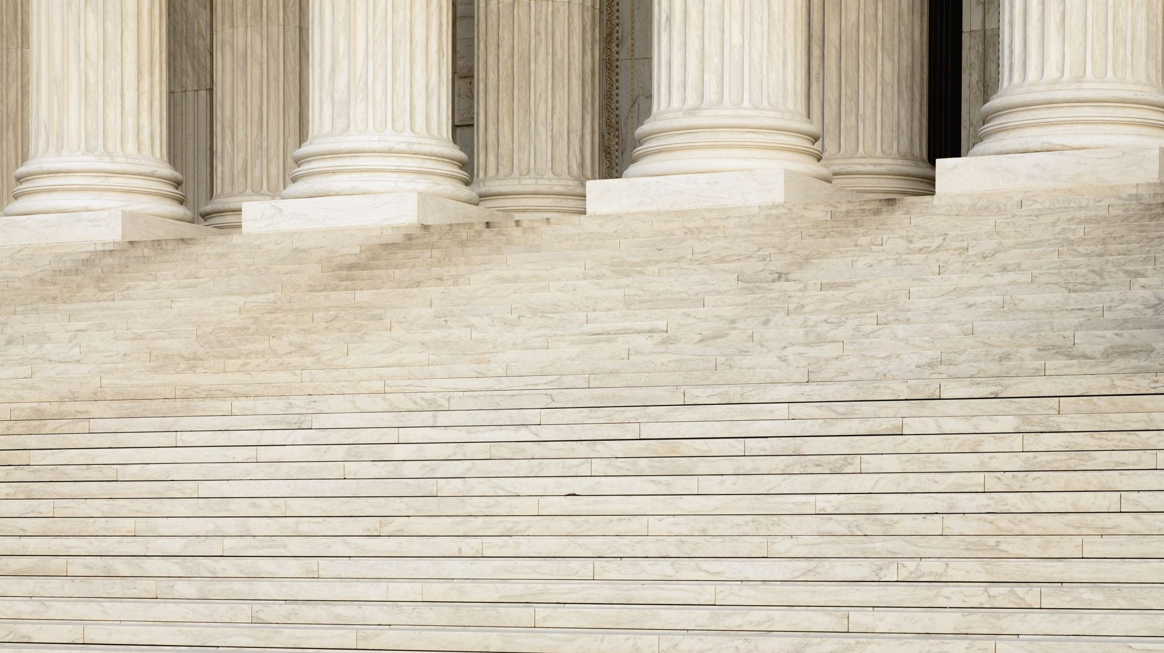
Criminal Law 101 - Basics

Slide 2
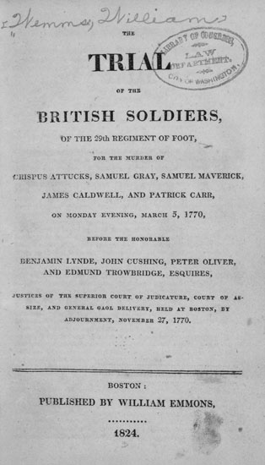
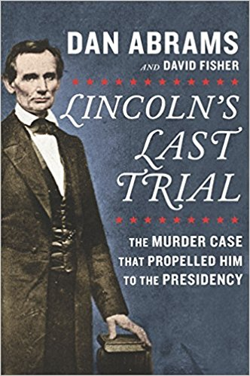
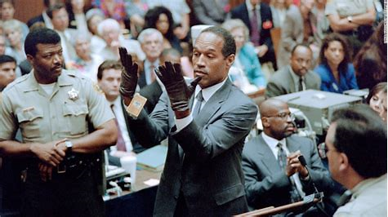
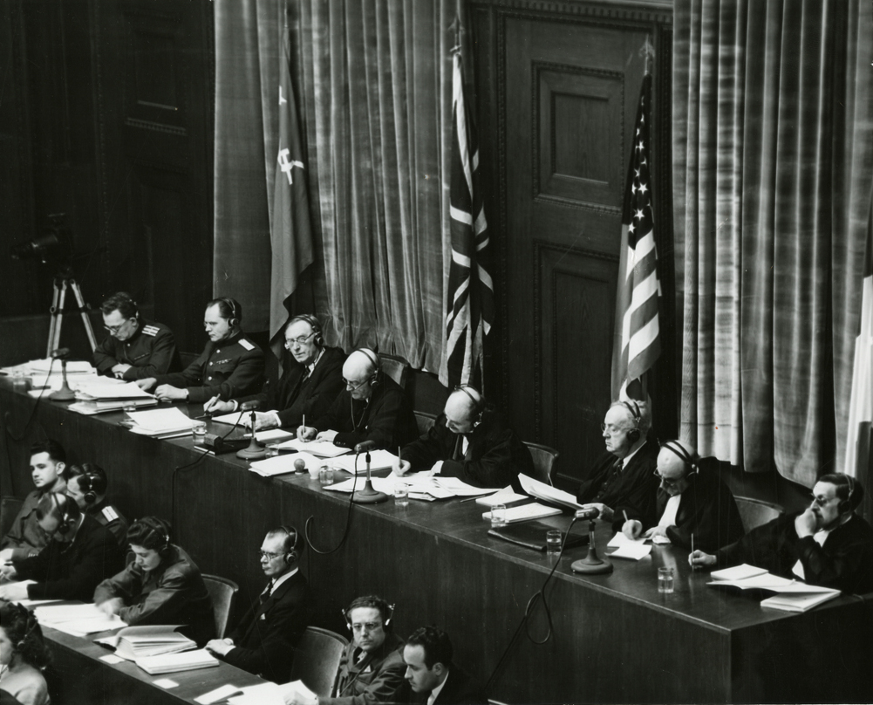

Slide 3
Criminal law may seem confusing at first – Let’s simply to get clarity

Slide 4
Need to understand concepts

Slide 5
Arrest or Summons
The government brings a person before the court to answer a criminal charge by:
1. Arrest on a warrant or service of summons issued pursuant to a complaint, information, or indictment. [FRCrimP. 4(a), 9(a), 58(d)(3)]
2. Arrest without a warrant.

Slide 6
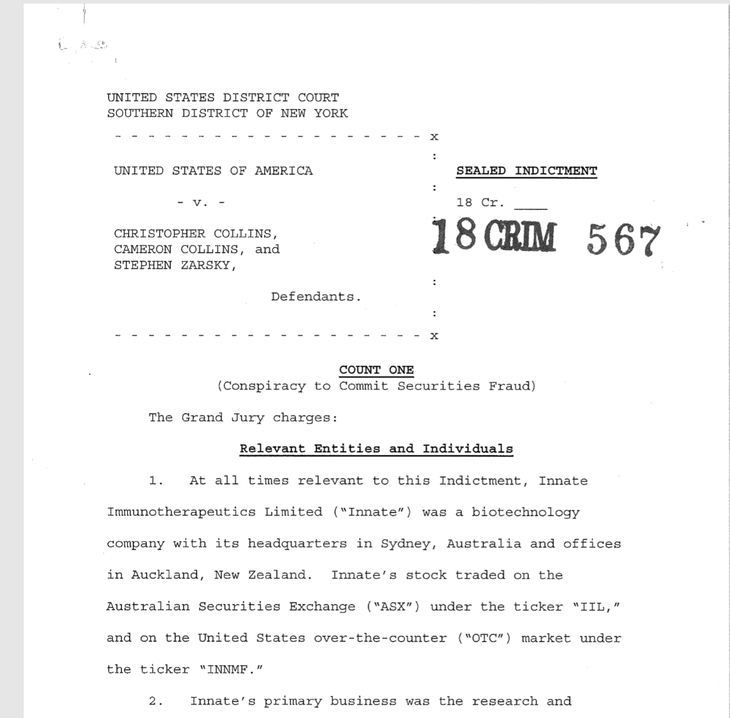

Slide 7
Speedy Trial Act
SPEEDY TRIAL ACT – 18 U.S.C. 3161
The date of arrest or service of a summons triggers some of the time requirements of the Speedy Trial Act.
The government must file an information or indictment within 30 days after arrest or service of the summons.
The trial must commence within 70 days after the filing of the information or indictment, or the defendants first appearance before a judicial officer, whichever is later, not counting periods of excludable delay. 18 U.S.C. 3161(c)(1).

Slide 8
“Excludable delay”
The Speedy Trial Act specifies periods of excludable time that can extend the specified periods. 18 U.S.C. §3161(h). In the computing the speedy trial clock, the court will not count specified periods of “excludable delay.” Periods of excludable delay include:
Delay resulting from any proceeding, including any examinations, to determine the mental competency or physical capacity of the defendant;
Delay resulting from trial with respect to other charges against the defendant;
Delay resulting from any pretrial motion, from the filing of the motion through the conclusion of the hearing on, or other prompt disposition of the motion;
Delay resulting from any proceeding relating to the transfer of a case or the removal of any defendant from another district under FRCP;
Delay resulting from the consideration by the court of a proposed plea agreement to be entered into by the defendant and the attorney for the government;
Ends of justice finding.

Slide 9
Discovery/esi
Rule 16. Discovery and Inspection

Slide 10
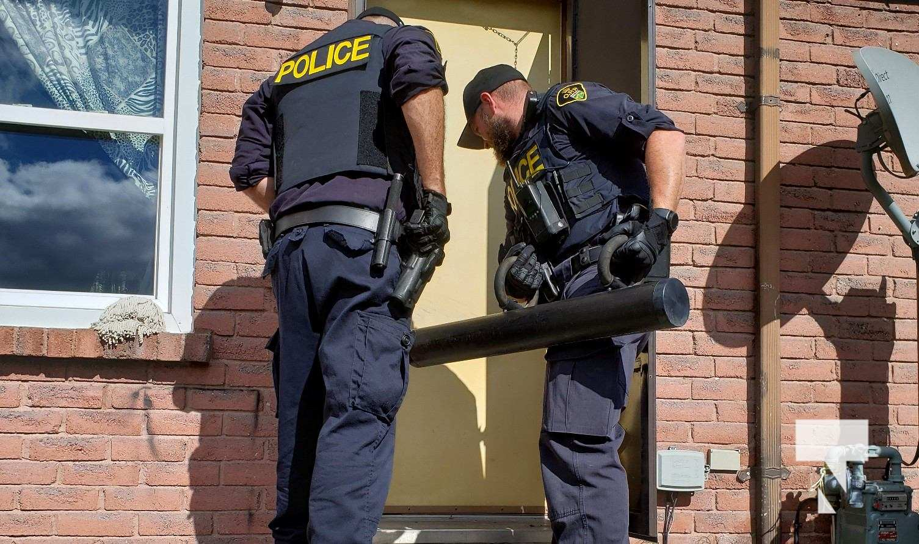
Criminal Discovery is a little different

Slide 11
Grand Jury Subpoena

Slide 12
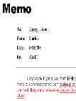
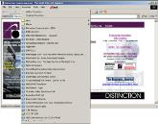
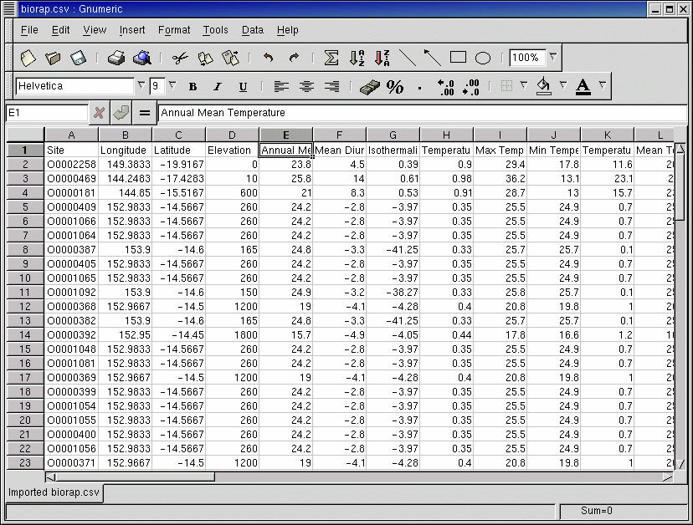
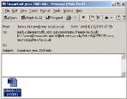
E -Documents Include
Web logs
Word processing documents
Graphic images
Spreadsheets
Email messages and attachments
Notes:
It now involves eDocs. Just to clarify, an eDoc is not just a PDF or a TIFF image. Those are scanned images. It is sort of like the difference between analog and digital. A PDF or a TIFF won’t have the metadata or other electronically created information that native documents that are in a computer may have.

Slide 13
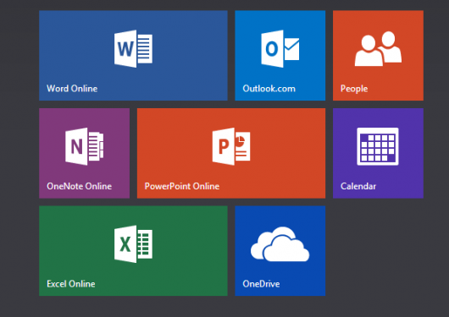
E-Discovery Has Expanded

Slide 14
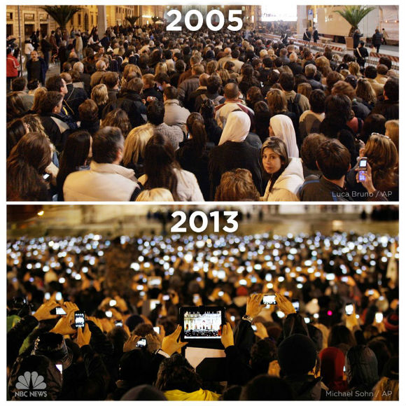

Slide 15
Working Towards Mastery of ESI
Achieve Mastery
Use The Strategy & Tools
Number of Cases
Get Familiar
With Strategy
Time Spent

Slide 16
David Allen

Slide 17
Getting Things Done

Slide 18
A discovery philosophy
Collect
Clarify
Organize
Review
Do

Slide 19
Model 299

Slide 20
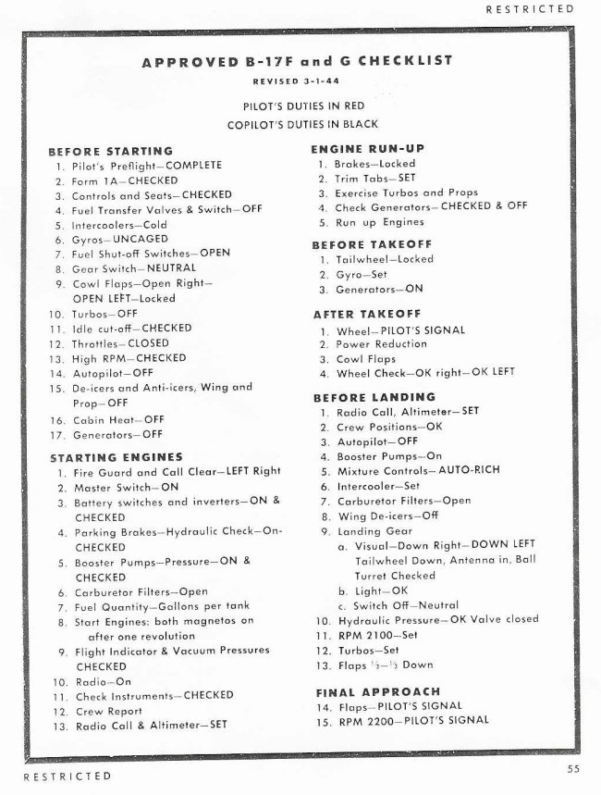

Slide 21
“Flying Fortress”

Slide 22
Use Checklists
Gawande makes a distinction between errors of ignorance (mistakes we make because we don't know enough), and errors of ineptitude (mistakes we made because we don’t make proper use of what we know).

Slide 23
Excel Spreadsheets

Slide 24
The Criminal ESI Protocols
Recommendations for ESI Discovery in Federal Criminal Cases issued by the Joint Electronic Technology Working Group (JETWG).
http://www.fd.org/odstb_esi.htm
Notes:
Who made them?
Joint Electronic Technology Working Group (JETWG)
Consists of representatives from:
Department of Justice
Federal Defender Organizations
Criminal Justice Act Attorneys
Office of Defender Services

Slide 25
Brady materials
Brady disclosure consists of exculpatory or impeaching information and evidence that is material to the guilt or innocence or to the punishment of a defendant. The prosecutor must disclose evidence or information that would prove the innocence of the defendant or would enable the defense to more effectively impeach the credibility of government witnesses.

Slide 26
Giglio Materials
A United States Supreme Court case in which the Court held that the prosecution's failure to inform the jury that a witness had been promised not to be prosecuted in exchange for his testimony was a failure to fulfill the duty to present all material evidence to the jury, and constituted a violation of due process, requiring a new trial.

Slide 27
Jencks act
18 U.S.C. § 3500, provides that the government (prosecutor) is required to produce a verbatim statement or report made by a government witness or prospective government witness (other than the defendant), but only after the witness has testified. Jencks material is evidence that is used in the course of a federal criminal prosecution in the United States. It usually consists of documents relied upon by government witnesses who testify at trial.
The material is described as inculpatory, favoring the United States government's prosecution of a criminal defendant

Slide 28
Rule 17. Subpoena
(a) Content. A subpoena must state the court's name and the title of the proceeding, include the seal of the court, and command the witness to attend and testify at the time and place the subpoena specifies. The clerk must issue a blank subpoena—signed and sealed—to the party requesting it, and that party must fill in the blanks before the subpoena is served.
(c) Producing Documents and Objects.
(1) In General. A subpoena may order the witness to produce any books, papers, documents, data, or other objects the subpoena designates. The court may direct the witness to produce the designated items in court before trial or before they are to be offered in evidence. When the items arrive, the court may permit the parties and their attorneys to inspect all or part of them.

Slide 29
Complex Case Designation

